Slide 1
AP Human Geography
Welcome to Boot Camp

Slide 2
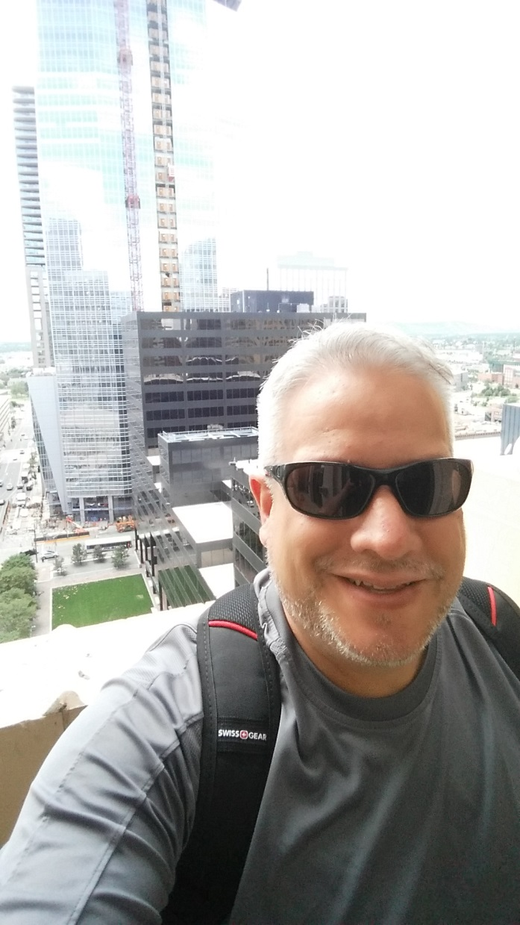
About Me
Native Coloradan
Born and raised in Denver
Graduated from:
Notre Dame Catholic
Mullen High School
University of Northern Colorado
University of Colorado – Denver

Slide 3
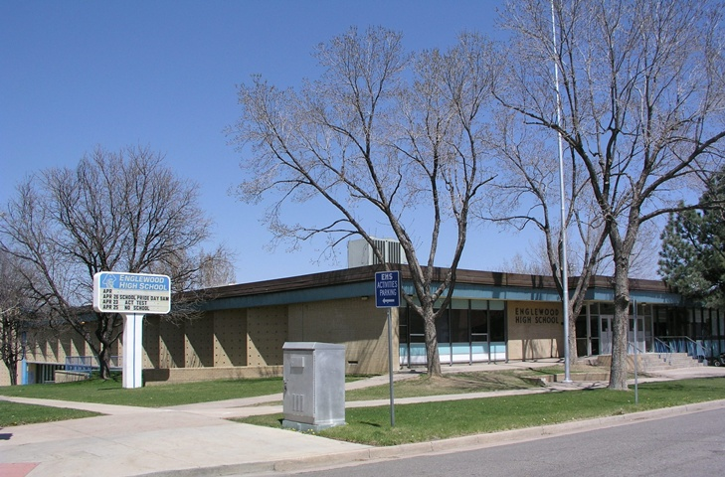
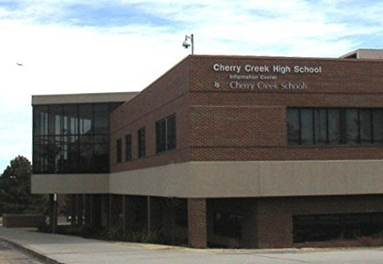
About Me
Taught at:
Manual HS (2 yrs)
Englewood HS (1 yr)
Cherry Creek HS (20 yrs)
Also worked at:
Ingenius – a defunct educational internet company

Slide 4
My Geography Experience
Geography Teacher 23 years
AP Human Geography
Teacher – 14 years
Reader/Table Leader – 11 years
Question Writer
Consultant for AP Teacher Community

Slide 5
My Geography Experience
Other Experience
Contributing Writer APHG Review book
Presenter at several conferences
Question writer, iScore5
COGA Teacher Consultant, Question writer

Slide 6
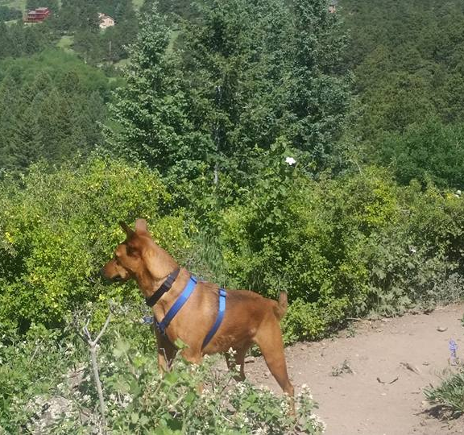
My Family
Wife - Julie
Married 23 years
Son - Ben
2014 Creek grad
Daughter - Andie
2017 Creek grad
Dog - Chewie

Slide 7
My Issues
Type 2 Diabetes
Stress, lack of exercise, and inconsistent eating patterns raise my blood sugar.
Because of this:
I have to eat on time – 5th period
You should not expect to drop in without an appointment.
I don’t do much work at home.

